Slide 1

Anti-Counterfeit Medicine Tracking System
Leveraging Blockchain for Pharmaceutical Supply Chain Integrity
Name: Gautam Rai
Roll No: 53
Class: D17C
Batch: B
Notes:
📍📍Dear Students,
For the BC Lab, prepare the case study demonstration based on the implementation in experiments 6, 7 & 8.
Case study ppt - 5 slides
1. problem statement & significance of Blockchain in the domain, key stakeholders, smart contracts involved
2. architecture diagram
3. implementation of experiments 6, 7 & and 8, one slide each.

Slide 2



Chapter 1 / Problem & Solution
The Problem: Counterfeit Drugs
The Solution: Blockchain Traceability
Counterfeit drugs pose a major global health risk due to unverified, ineffective, or harmful ingredients.
Manufacturers face substantial financial losses and damage to consumer trust.
Existing solutions, such as holograms and barcodes, have failed to fully verify authenticity or address these challenges.
Current tracking systems and supply chain management remain fragmented and lack transparency, making them difficult to secure.
We propose a decentralized, immutable ledger system to track every drug batch.
Registration
Manufacturers anchor drug batches on the chain.
Transfer Confirmation
Wholesalers and pharmacies confirm secure handoffs.
Verification
Consumers scan and verify authenticity and provenance.

Slide 3
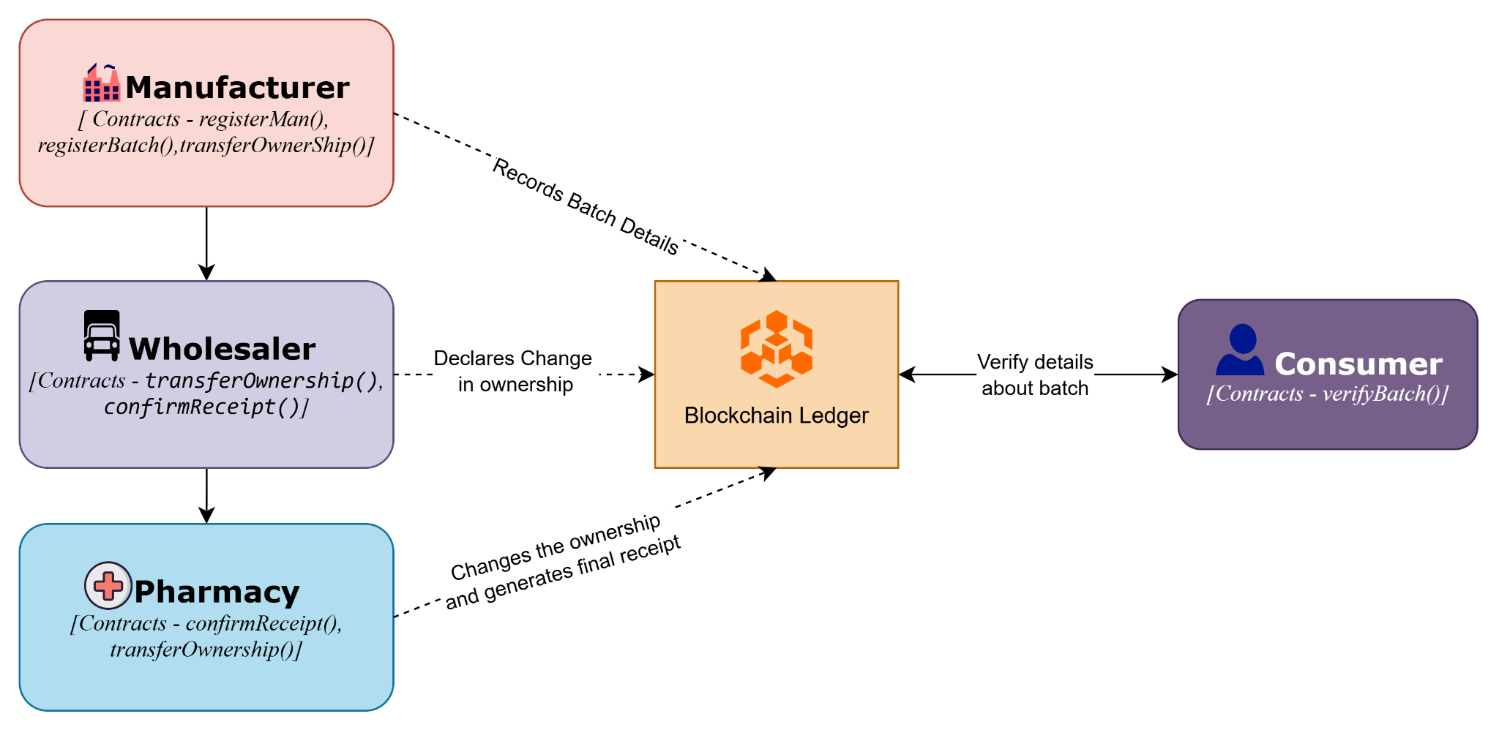
Chapter 2 / Stakeholders and Contracts

Slide 4
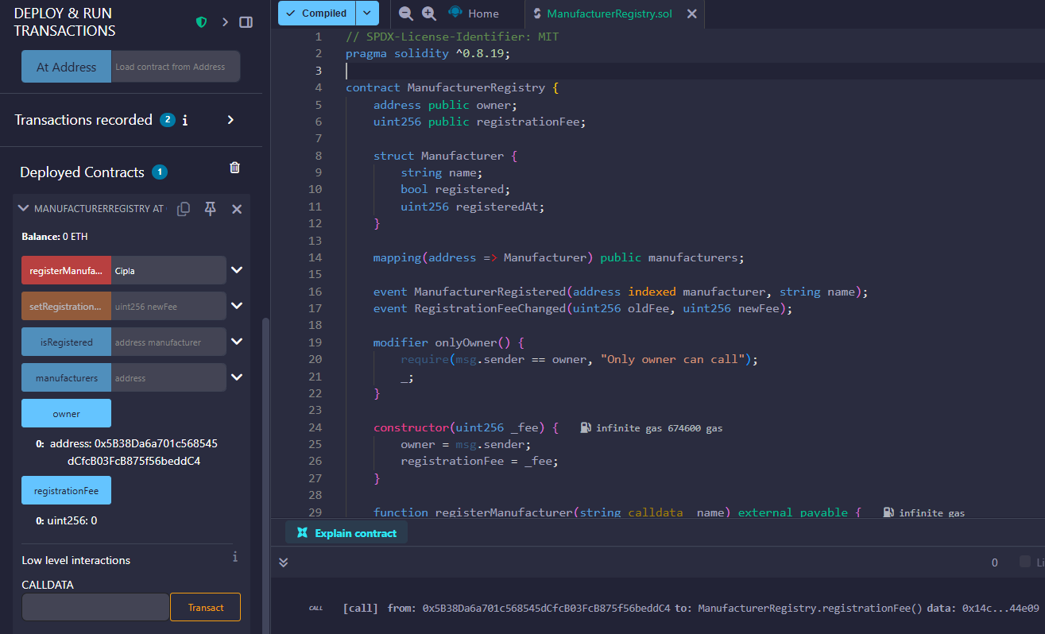
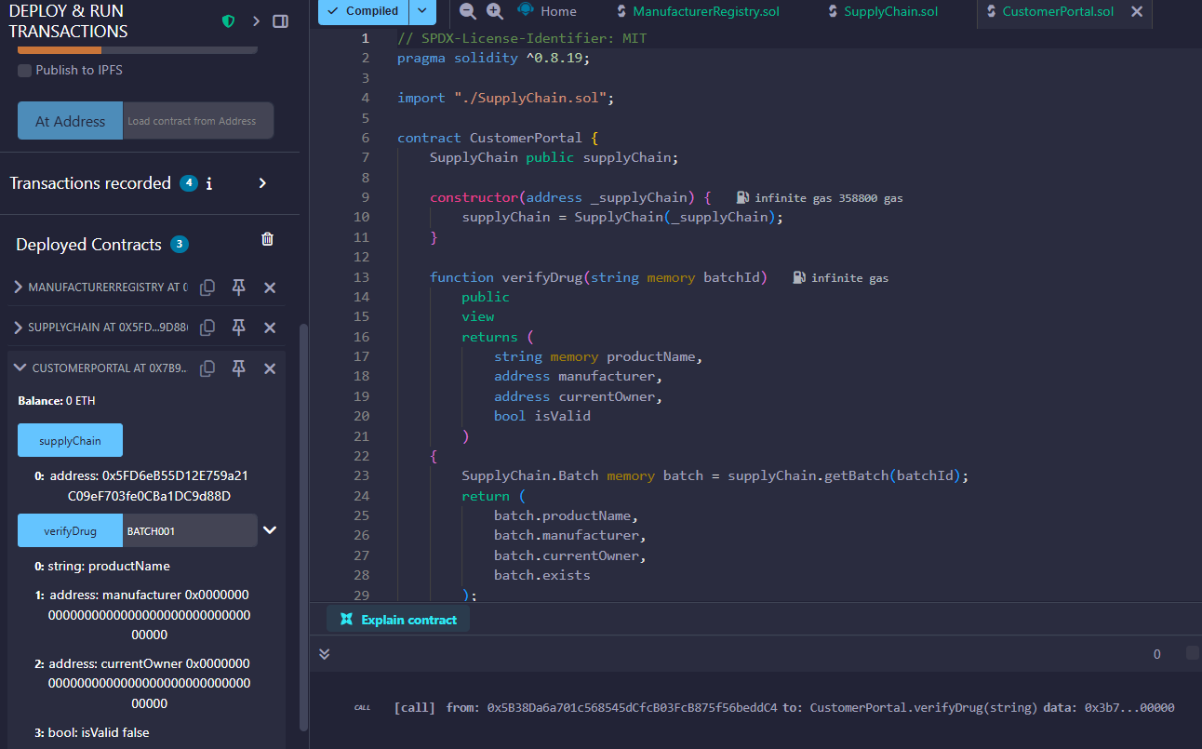
Chapter 3 / Smart Contracts [Exp 6]
CustomerPortal.sol
ManufacturerRegistery.sol

Slide 5
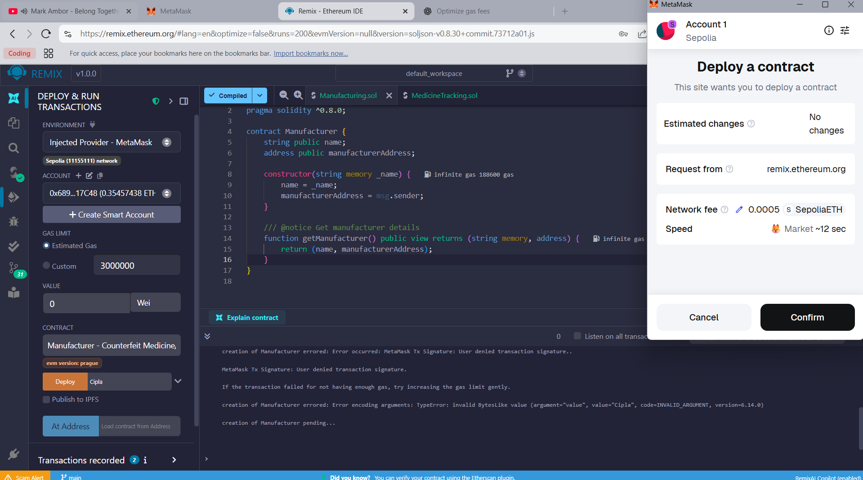
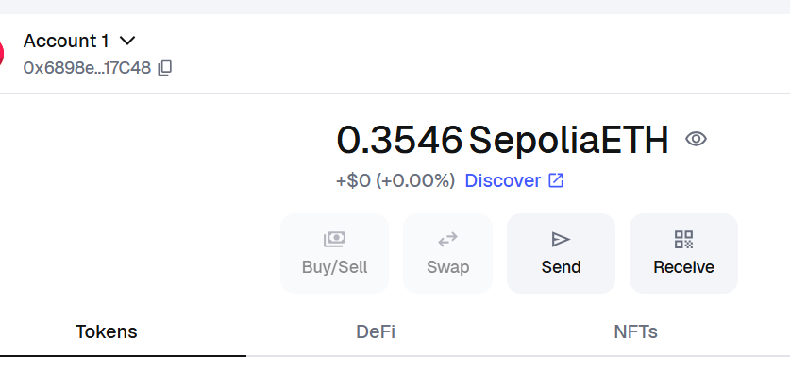
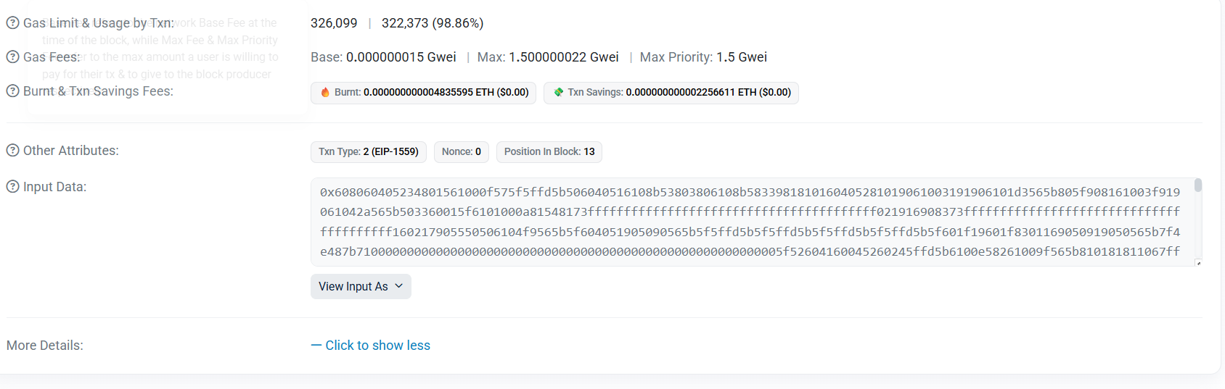
Chapter 4 / Using Sepolia TestNet [Exp 7]

Slide 6
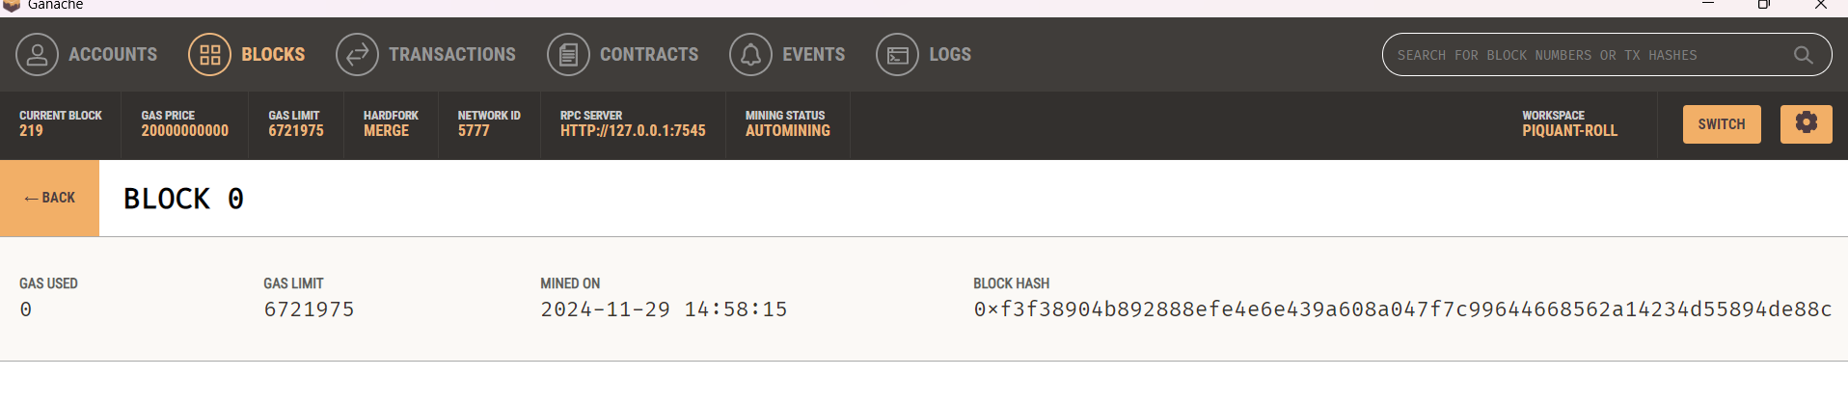
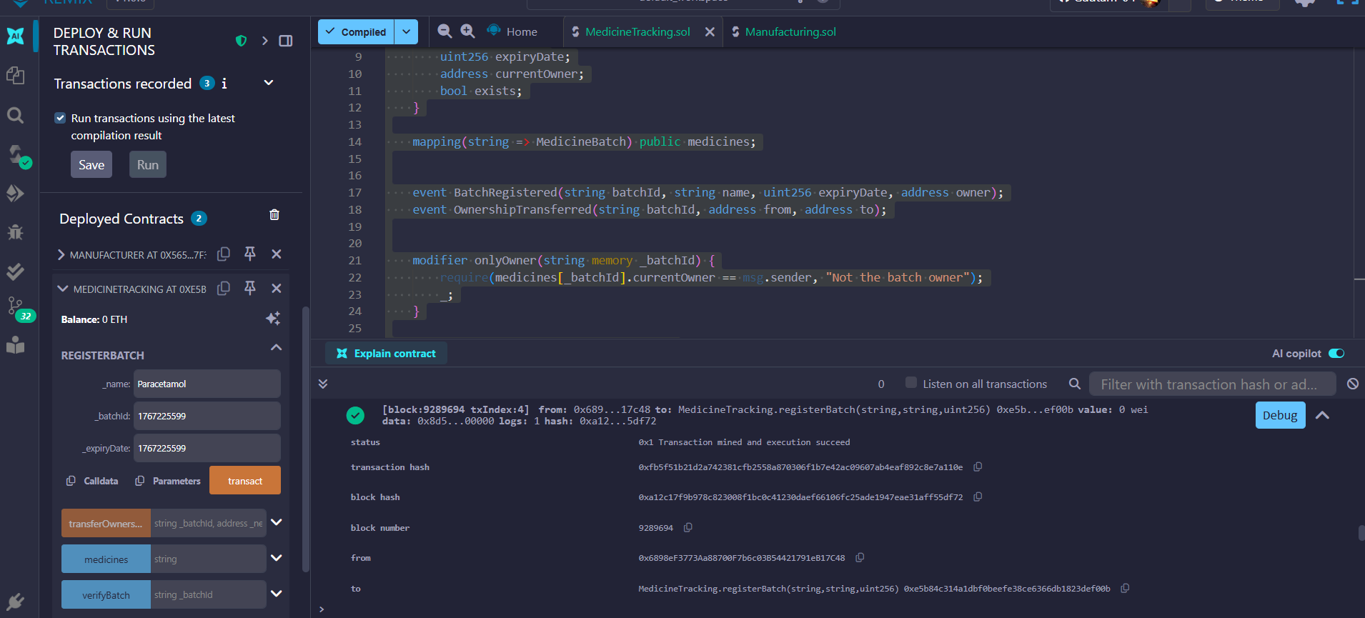
Chapter 5 / Using Ganache [Exp 8]

